Slide 1
Trust & Choice of Partners
Charles A. Holt, University of Virginia
Erica R. Sprott, Harvard University
January 2023
Notes:
I’m excited to present the preliminary results from this joint work with Charlie Holt at UVA. Today I’m going to talk about a series of experiments in which we see how competition can promote pro-social behavior in a market setting

Slide 2
Impersonal Markets and Personal Interactions
Outcomes in market experiments may conform to classical (selfish, rationality-based) predictions of economic theory
Imperfect information blurs fairness comparisons
Competition masks effects of punishments
Endowments are more legitimate in a market setting
Competition can promote other-regarding behavior in personal interactions when people can choose who to deal with and who to avoid
Notes:
There are instances in which outcomes in market experiments can conform closely with the classical, rationality-based predictions we teach in ECON 201 and 202. Even in small group settings, imperfect information can obscure ideas of, or awareness of fairness / equity in outcomes amongst participants. Competition can mask the effects of punishments for selfish behavior. Endowments, or initial imbalances in wealth or resources are also typically seen as more legitimate in a market setting.
But, there are also instances in which competition in market experiments can promote other-regarding, nonselfish behavior – by which we mean greater amounts of trust in other participants, reciprocity, and better outcomes overall. These instances are those in which people can choose who to deal with and who to avoid.

Slide 3
Impersonal Markets and Personal Interactions
V. Smith and Wilson (2019): Personal Social vs. Impersonal Economic
Adam Smith : Friends & Family vs. Market worlds
Impersonal markets in developed economies provide exit options that are not otherwise available or even desirable in personal relationships
Even in markets with exit options, competition can lead to behavior that is not purely self-interested
Conduct series of experiments using Veconlab software illustrating how competition between potential partners in a Trust Game can foster other-regarding behavior
Notes:
Vernon Smith and Bart Wilson’s 2019 book Humanomics discusses Adam Smith and his conception of two spheres, two worlds – the personal social, and the impersonal economic, and the very human problem of simultaneously living in these two worlds.
How do we distinguish between these two markets? Consider (1) your family, and (2) your grocery store, or your mechanic. Those impersonal economic markets provide easy exit options in which you can find a new grocer, or a new mechanic; that might otherwise not be available in the personal social world.
Even in markets with these exit options, competition can lead to behavior that is not purely self-interested.
We conducted a series of experiments using the Virginia Experimental Economic Lab software that illustrate how competition between potential partners in a trust game can foster this other-regarding behavior
“Humanomics, the very human problem of simultaneously living in these two worlds, the personal social and the impersonal economic.”

Slide 4
Preview of Results
Increased competition →
Specialization in profitable partnerships
Passing to one partner with high trust levels
Cutting off less profitable links over time
Higher levels of trust overall
Notes:
Before I discuss more background work and the setup of the experiment, I want to briefly preview the results.
Through varying the levels of competition between potential partners in a trust game, we find that increased competition leads to specialization in profitable partnerships, and higher levels of trust overall.
What does this look like? Passing to one or few partners with high levels of trust, who engage in the most other-regarding behavior, and cutting off less profitable links over time.
4 minutes , maybe a little under!

Slide 5
Prior Work: Holt, Johnson, and Schmidtz (2016) on Adam Smith
Scale Intensity and Trust: People create their own networks of trusting relationships and scale them if they work and exit otherwise.
Choice of Partners Prisoner’s Dilemma Game: With positive payoffs for cooperation outcomes, negative payoffs for mutual defection and a 0 payoff for both if either chooses to exit
Mutual Consent on Scale of Interactions: Experiment in which each person selects a proposed payoff scale (0x for exit, 1x, 2x, 3x), and the minimum of the proposed scales is implemented for the simultaneous move prisoner’s dilemma
Notes:
This paper with Charlie has its foundation in earlier work of his with Cathleen Johnson and David Schmidtz in which they used a Choice of Partners Prisoner’s Dilemma Game to see how people create their own networks of trusting relationships and scale them up. This game operates in two phases in each round:
In the first phase, potential partners have to agree on a scale of interaction. Think of this as the ‘stakes’ of the relationship. The lowest stakes possible, scale 0, is analogous to exiting the relationship / deactivating a link between you and your partner. At the highest scale of 3 there is high potential for gains but also high potential for losses. Both partners choose a scale of interaction, the minimum value of which is used as the scale that round for those partners.
One a pair of partners have agreed on a scale of interaction in the first phase, they then participate in a prisoner’s dilemma. This has the traditional setup fo positive payoffs for mutual cooperation, negative payoffs for mutual defection, and a payoff of 0 for both if either chooses to exit.

Slide 6
Prisoner’s Dilemma Incentives
Dominant Strategy: Defection results in an extra $1 in current earnings, regardless of whether the other person cooperates or defects
Repeated Games: In a repeated game, defection hurts earnings in later rounds
Multiple Partners: Defection is worse in a repeated game when you can meet new people, creating a “poison pool” of partners with no trust
Notes:
The incentives are such in a Prisoner’s Dilemma experiment that the dominant strategy in a one-shot game is always to defect. Defection results in an extra $1 in current earnings, regardless of whether the other person chooses to cooperate or defect.
Cooperation is optimal for the group but suboptimal for the individual
Theory does not so straightforwardly predict defection in an iterated game in which each round is an isolated playing of the prisoner’s dilemma with each partner
Defection is even worse when you can meet new people, can defect and then discard a previous relationship in exchange for a new one, as you would be able to in a market setting (conditional on the legality of that defection)

Slide 7
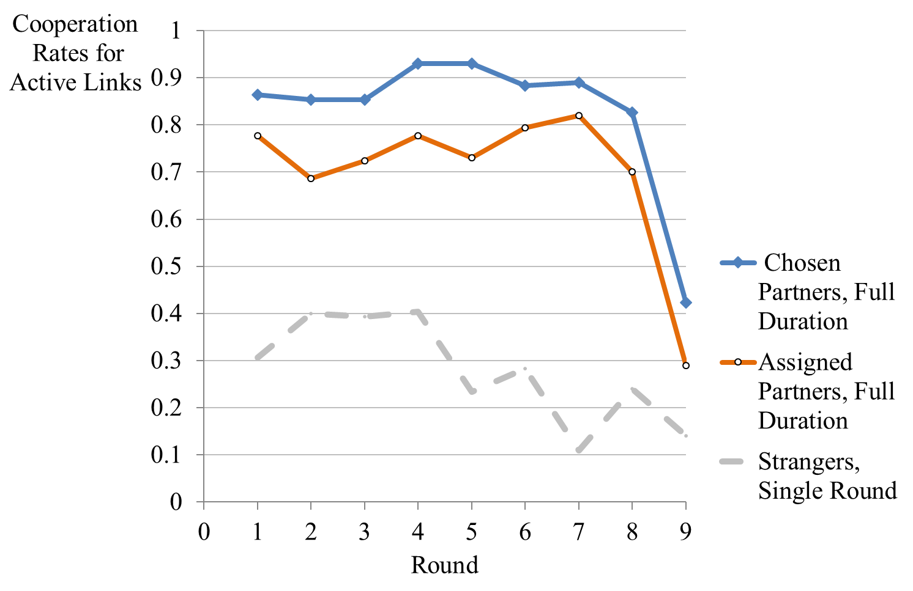
Sustained High Cooperation in a Prisoner’s Dilemma (Holt, Johnson, and Schmidtz, 2016)
Notes:
In an experiment also done on Veconlab software, they find that as you can see above:
Cooperation rates in an iterated prisoner’s dilemma with partners are much higher than those in single, one-shot games
Providing participants with opportunities to choose their partners, forming their own profitable relationships, increased cooperation rates even further
Something important to note here is that we can see in the final round, which is preannounced as the last round, cooperation rates drop drastically. Participants look forward to the future and see that there is no next round relationship they need to maintain.
Keep this in mind going forward
Note that cooperation rates drop in the final round: 9

Slide 8
Trust Beyond the Prisoner’s Dilemma
Trust is typically measured in field experiments with a Trust Game instead of a prisoner’s dilemma.
Game involves passing amounts of money back and forth, in a manner that is analogous to providing money to an entrepreneur, who then shares part of the resulting profits with the original investor.
Scale is naturally determined in a trust game by the first mover’s pass amount
Measures of “trust” and “trust worthiness” are correlated with pro-social economic behaviors, or even with overall measures of economic development.

Slide 9
Combination of Two Games
Choice of Partners Game + Trust Game
Increase competition among potential partners in the Choice of Partners game with Trust Game pass/return mechanism
Each round:
Participants are exposed to a new potential partner and decide whether to link
First movers choose amount to pass, which is tripled
Second movers choose amount to return

Slide 10
Combination of Two Games
$3 endowments—amount available to pass increases as number of potential active links increases ($3 per potential link)
At most 3 links can be active – participants must choose with whom to deal
Both movers must agree to activate a link at a cost of $1 each

Slide 11
Combination of Two Games
Treatments designed to vary strength of competition between potential links
No cross pass: Maximum of $3 pass to any partner
Cross pass: $ from potential links can be passed in any amount to any partner
Preannounced number of rounds
Preliminary experimental data
3 sessions of each treatment
Number of independent observations is limited for statistical testing

Slide 12
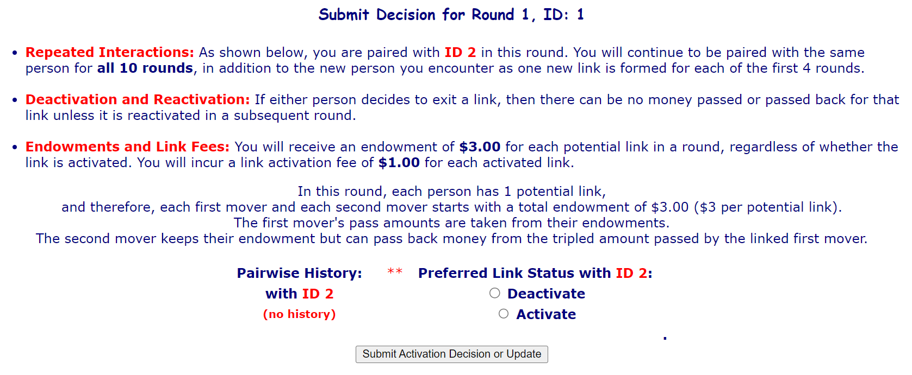

Slide 13
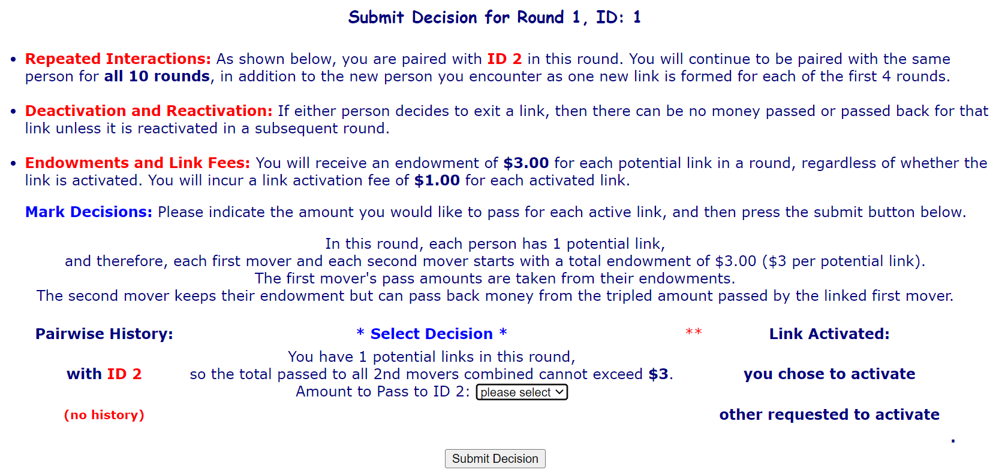

Slide 14
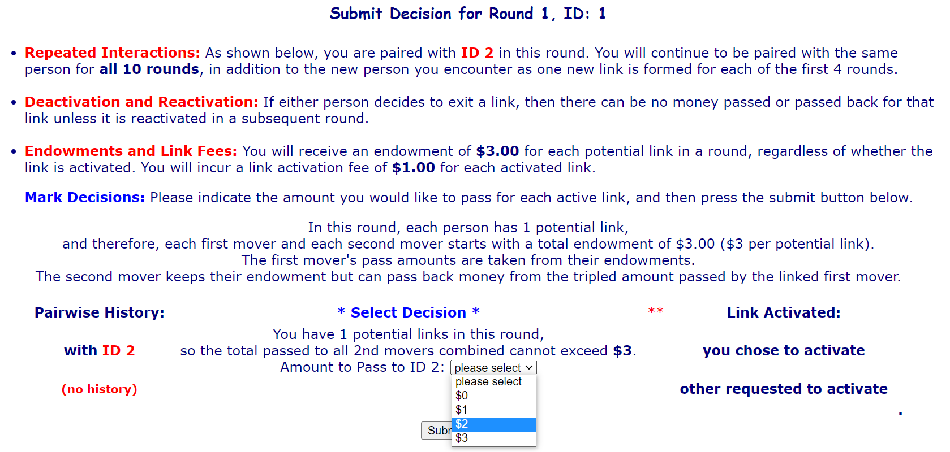

Slide 15
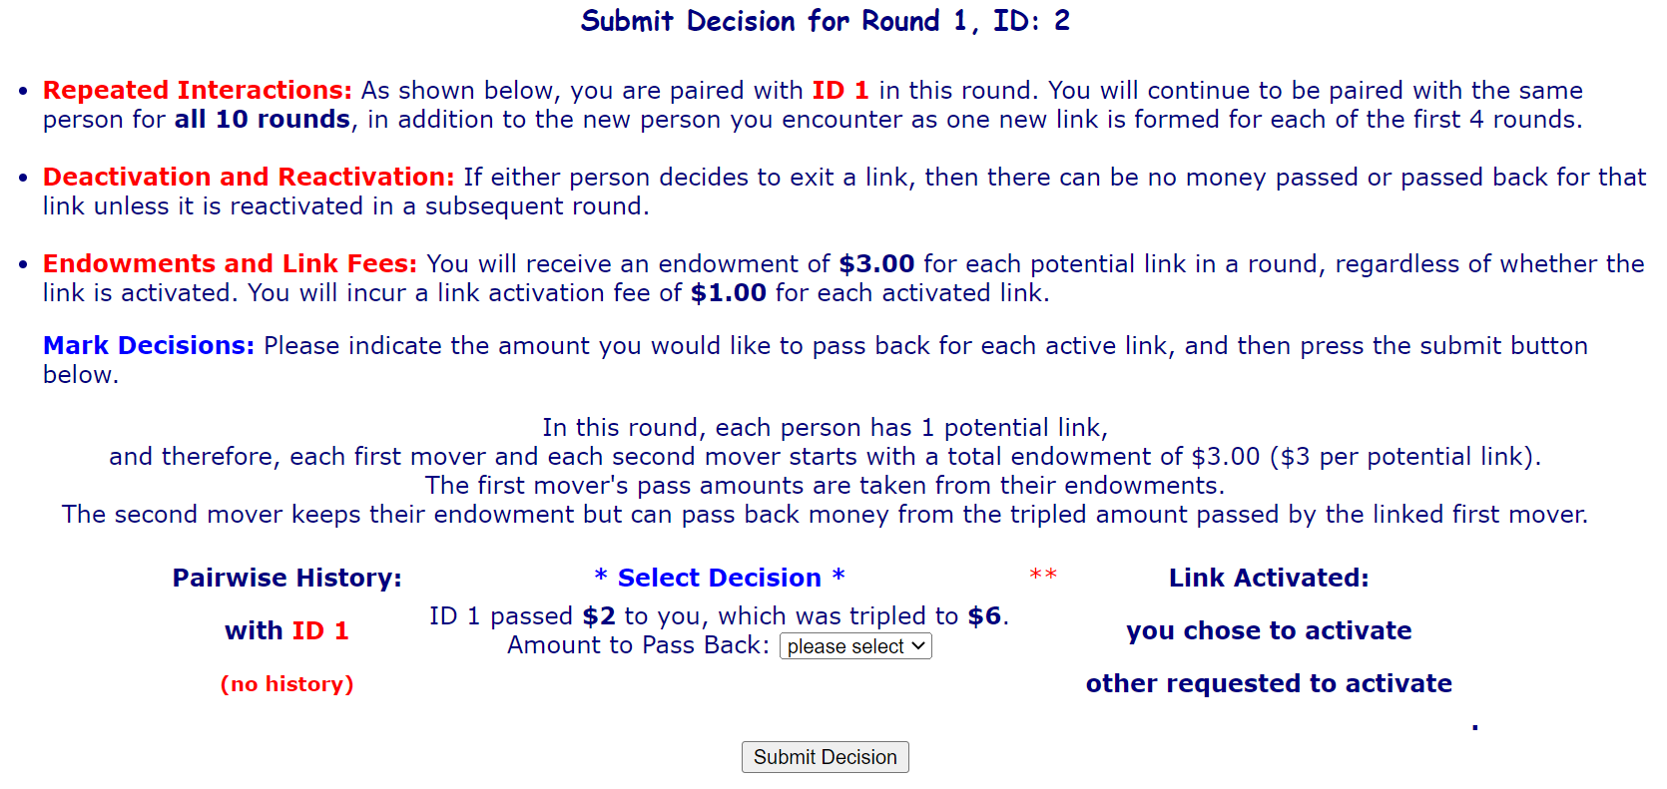

Slide 16
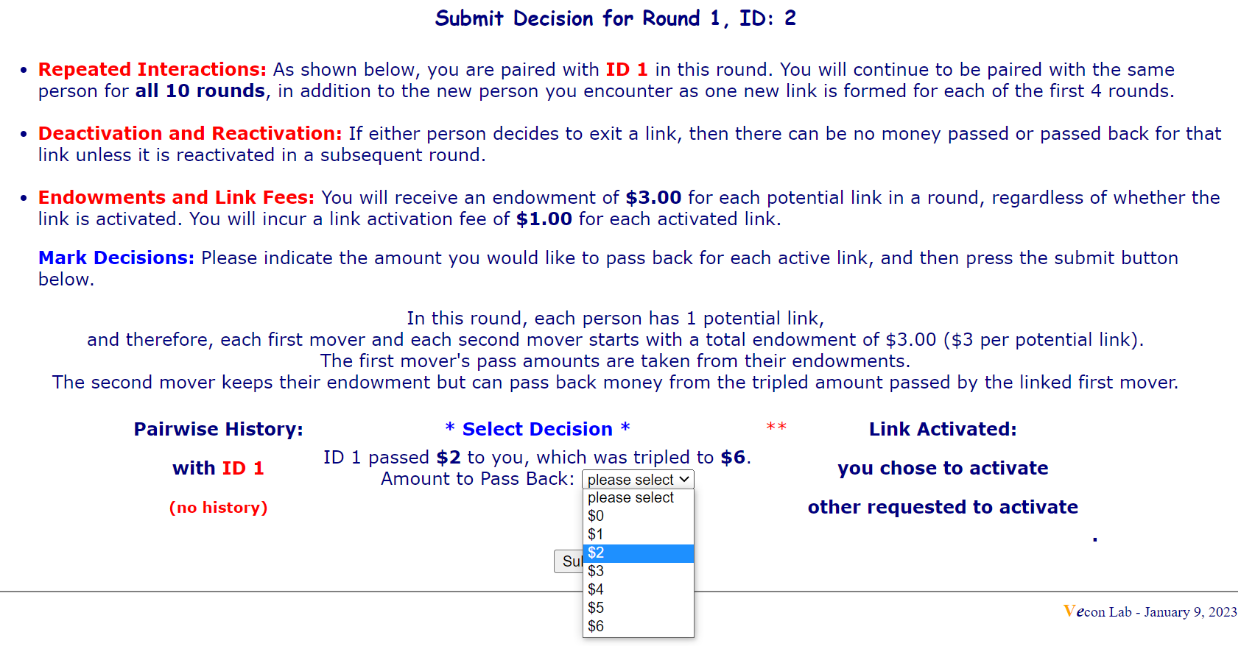

Slide 17
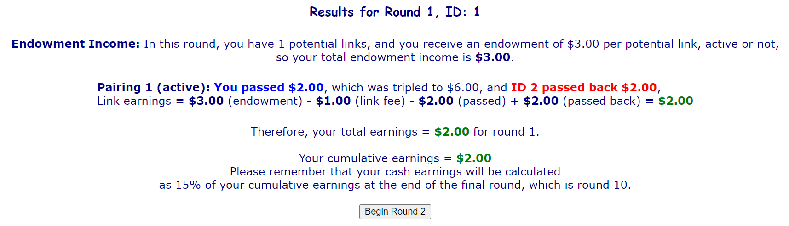

Slide 18
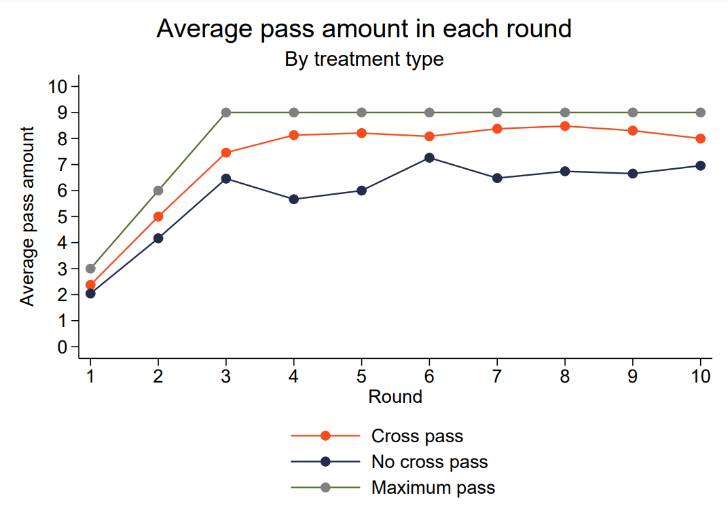
Average Pass Amounts
Higher amounts are passed in the cross-pass treatment.
Trust is strong even in the final round, in contrast to the Prisoner’s Dilemma Choice of Partners Game (slide 7)

Slide 19
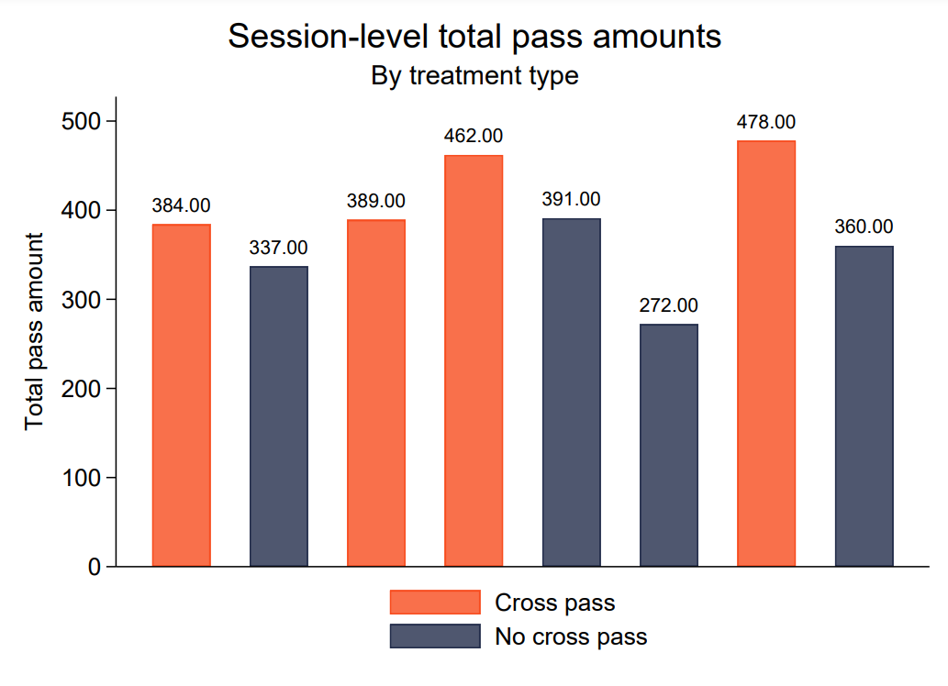
Total Pass Amounts
Round-level averages: Cross-pass treatments have higher total pass amounts
Session-level averages also show a trend of higher total pass amounts in cross-pass treatments as participants specialize in profitable links and scale them up by passing more

Slide 20
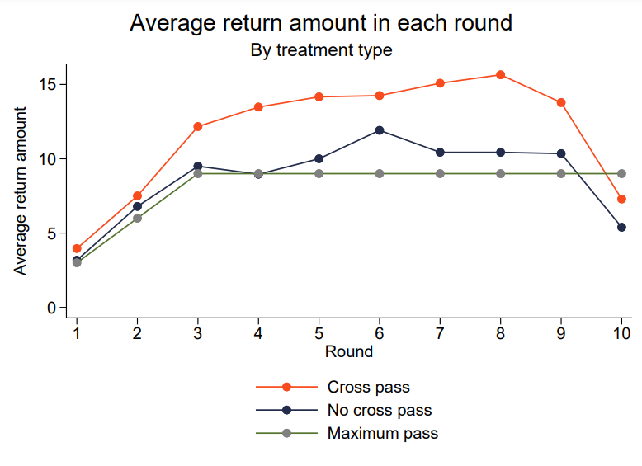
Average Return
Higher return amounts in the cross-pass treatment
Final period drop-off in return amounts.
Return amounts in both treatments are above the maximum possible pass amount until final round

Slide 21
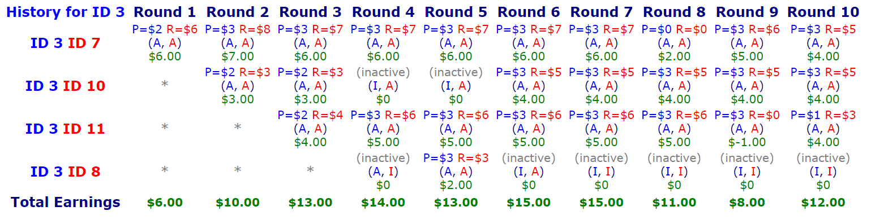
Case Study #1: No Cross-Pass
Second mover ID 7 in the top row started off returning almost all the tripled amounts in initial rounds.
Without the opportunity to cross-pass, first movers tend to maintain links with the maximum number of second movers (3).

Slide 22
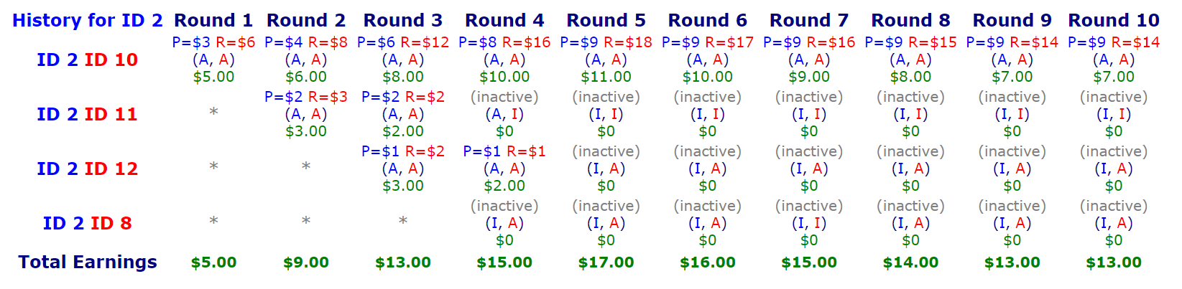
Case Study #2: Cross-Pass
Given the opportunity to cross-pass, first movers tend to specialize and scale up links with exceptionally responsive second movers and deactivate other links

Slide 23
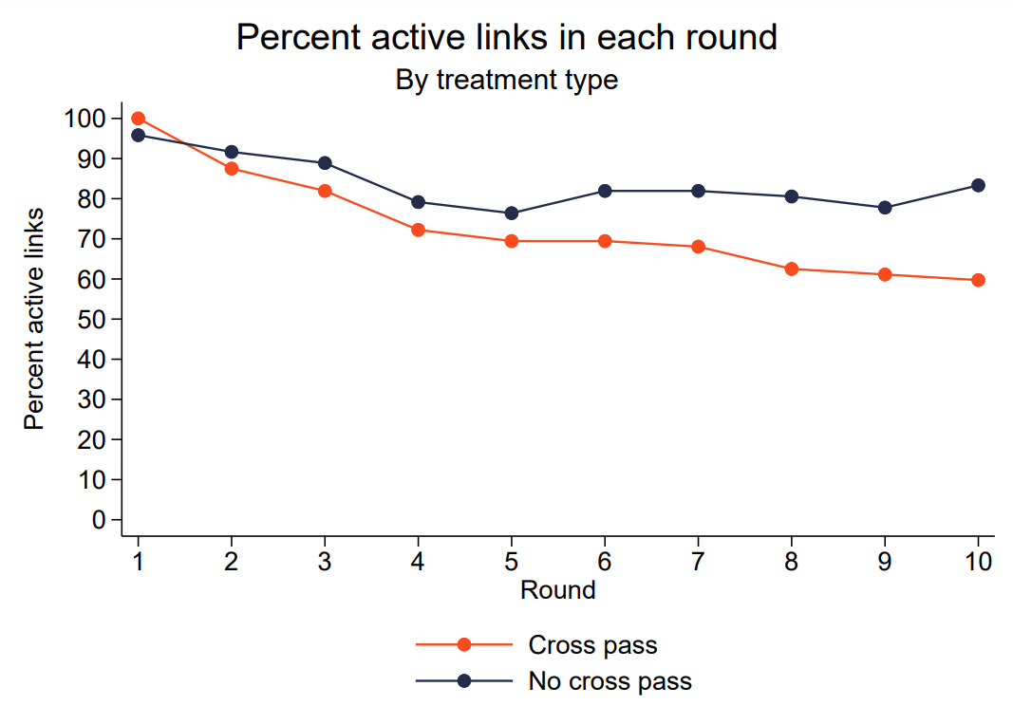

Slide 24
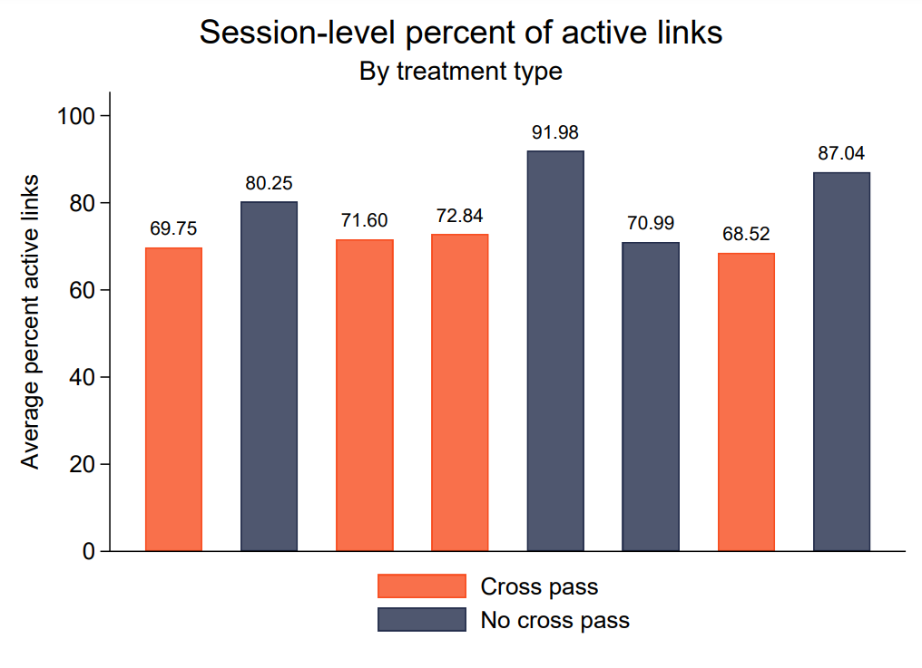
Active Links
Round-level averages: Cross-pass treatments have lower percent active links after round 1
Session-level averages also show a trend of lower percent active links in cross-pass treatments as participants specialize in profitable links

Slide 25
Discussion
Potential Mechanisms:
Increased flexibility in relationships
Increased competition between potential partners
No cross-pass treatments → more active links since first mover can’t concentrate everything on one link
Some potential partners get left out during the process of creating trust and profitable relationships

Slide 26
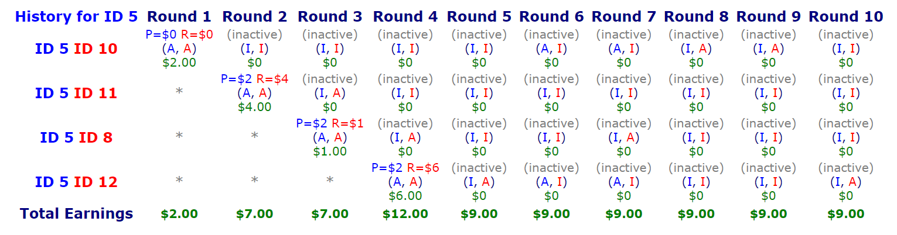
Discussion: Case Study #3

Slide 27
- Adam Smith, A Theory of Moral Sentiments, VII.iv.27
"We trust the man who seems willing to trust us. We see clearly, we think, the road by which he means to conduct us, and we abandon ourselves with pleasure to his guidance and direction."

Slide 28
Thank You!

Slide 29
Appendix: Statistical Significance
Difference in total pass amounts between treatments
Two-tailed p-value: 0.0454
Confidence interval:
The mean of (Cross Pass) - (No Cross Pass) = 88.25
95% confidence interval of this difference: (2.472011, 174.028)
Intermediate values used in calculations:
t = 2.5174
df = 6
SE of difference = 35.05561

Slide 30
Appendix: Statistical Significance
Group | Group 1: Cross Pass | Group 2: No Cross Pass
Mean | 428.25 | 340
SD | 48.692 | 50.444
N | 4 | 4

Slide 31
